Slide 1


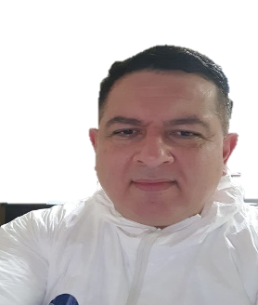


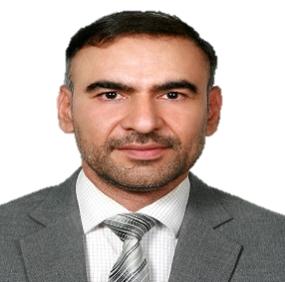
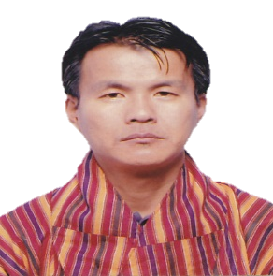
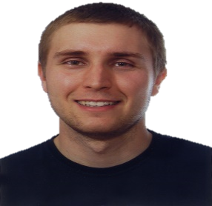
COVID-19: Situation, Response, Lessons Learned (Series#2)
Afghanistan | Bhutan | Guatemala | Italy
Date: August 28, 2020 | Time 1:30PM GMT | 7:15PM NTP | 3:30PM CET | 6:30AM PST
Dr Ziaulhaq Mansoor Ahrari
Herat Institute of Health Sciences
Afghanistan
Dr. Karma Tenzin
Faculty of Postgraduate Medicine, KGUMSB
Bhutan
Dr. Jose Ortiz
University San Carlos of Guatemala
Guatemala
Francesco Nicoli
University of Ferrara
Italy
  Registration Link - https://forms.gle/semMtEeQnqKRVFrD8

